Slide 1

Department
of
Computer Engineering
CEN 263
Digital Design
Autumn 2024
Lecture 9

Slide 2
Week 9 Outlines
FSM Examples
Single-Core Processor
Memory - RAM - SRAM - DRAM
Single Cycle Datapath
Control Unit

Slide 3
New Assignment! ATM
What are the states?
Draw state diagram.

Slide 4
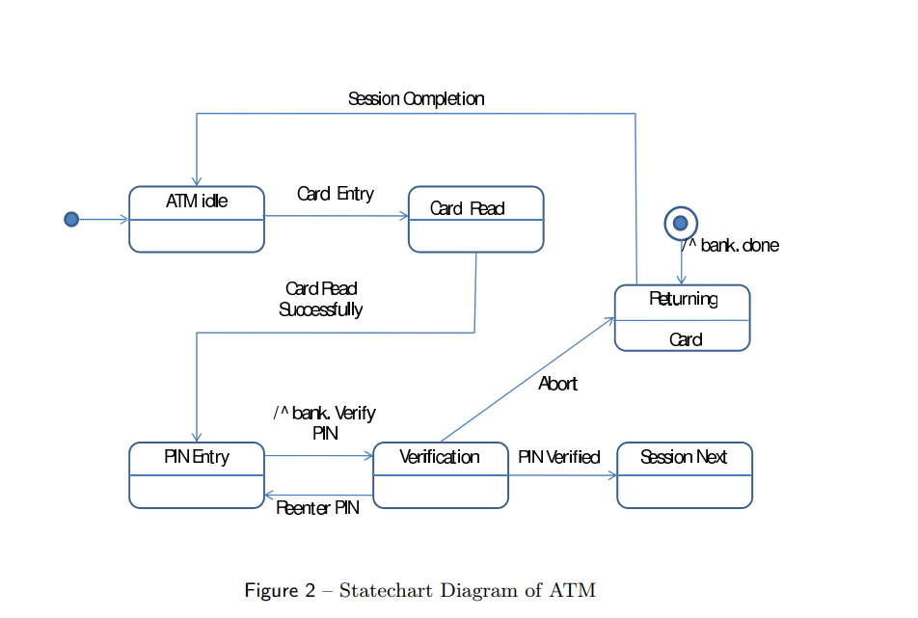
Assignment! ATM 1: - Check the paper I shared with you..

Slide 5
Assignment ATM 2:
States
Start
s - request PIN
Finish
h - session finished
e - session finished with error
Intermediate
q0 - choose option in main menu
q1 - making transaction
q2 - enter sum to withdraw
q3 - output account cash
q4 - enter cash to replenish
q5 - enter sum and account to transfer
q6 - enter a pin to change
Actions
Pins
p0 - wrong PIN
p1 - correct PIN
Menu
m0 - returning to menu
m1 - choosing invalid option at menu
Finishing
e0 - finishing session
e1 - system error
Other
z0 - choosing to withdraw cash
z1 - asserting withdrawing
z2 - checking account
z3 - choosing to replenish cash
z4 - asserting replenish
z5 - enter sum again
z6 - choosing to transfer sum
z7 - asserting transfer
z8 - enter account again
z9 - choosing change pin
z10 - enter a pin again (wrong pin)

Slide 6
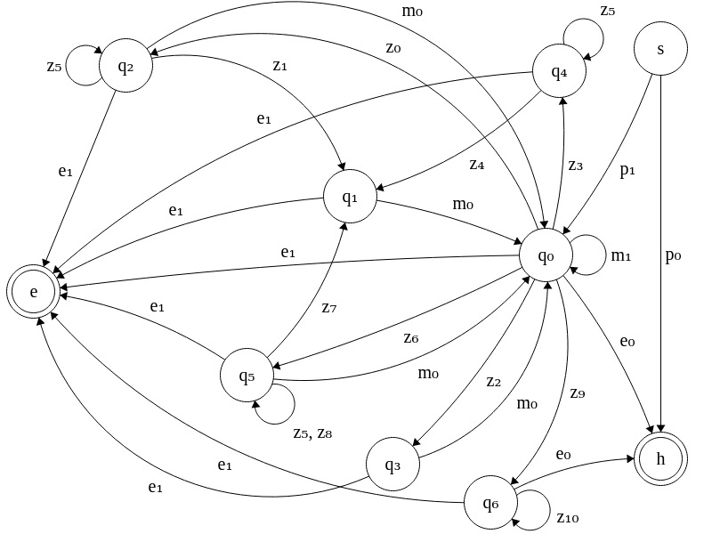
New Assignment! ATM

Slide 7
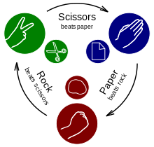
New Assignment!
How can I implement Rock - Paper - Scissors game with Logic Gates?
https://en.wikipedia.org/wiki/Rock_paper_scissors

Slide 8

Recap - Latch

Slide 9
Memory - RAM - SRAM

Slide 10
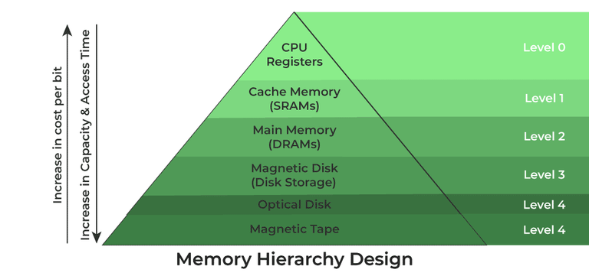
Memory

Slide 11
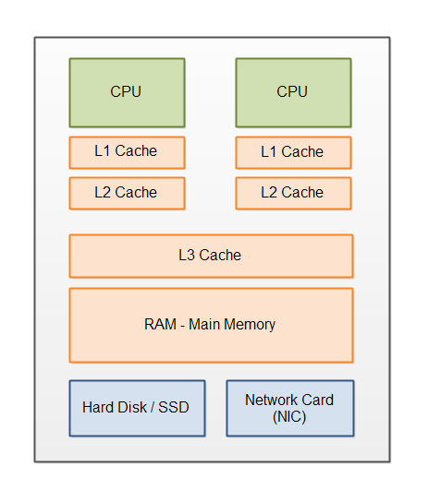
CPU & Memory

Slide 12
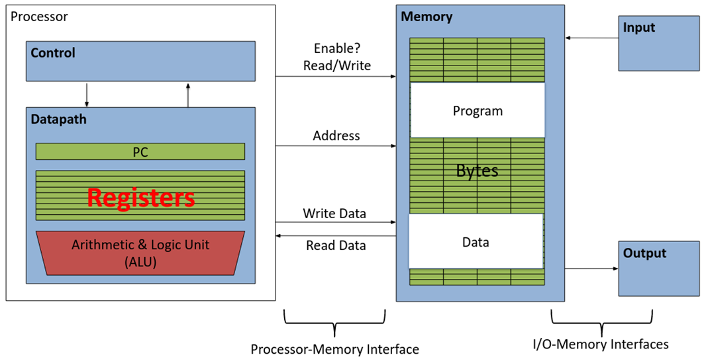
Registers are Inside the Processor (Memory is Not!)

Slide 13
Memory vs. Registers
Memory is different from registers
Memory is in a different location on hardware
We don’t have space for 2³² registers on the processor!
The memory unit is abstracted away for this class
Memory accesses are usually much slower than register accesses, but for now we’ll assume they’re about as fast as register accesses
In a couple weeks, we’ll see how we can achieve this with caches

Slide 14
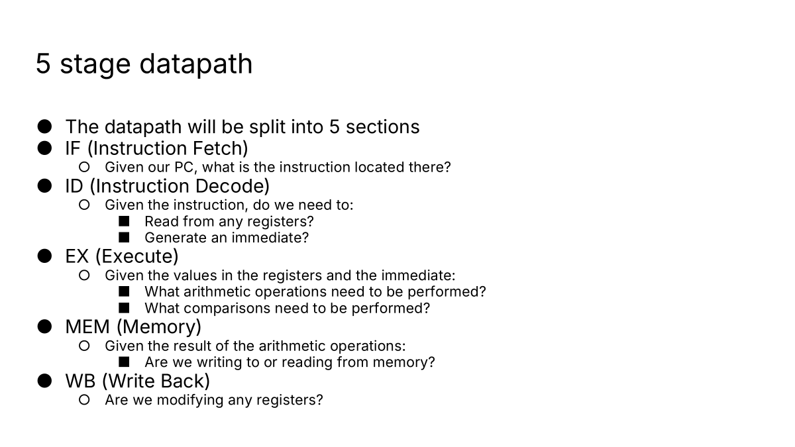
Single Cycle Datapath

Slide 15
Read/Write Memory
Behavior:
MemAddress identifies an address in memory.
Reading from memory: Set MemReadData to the value at that address.
Writing to memory: If MemWEn=1, then on the next rising edge of the clock, write the value in MemWriteData at that address.
Inputs | MemAddress | 32 bits
 | MemWriteData | 32 bits
 | MemWEn | 1 bit
 | Clock | 1 bit
Output | MemReadData | 32 bits
MEM
MemAddress
MemReadData
MemWriteData
MemWEn

Slide 16
Is MEM a state or combinational logic element?
State element for writes to memory
Combinational logic element for reads from memory
Inputs | MemAddress | 32 bits
 | MemWriteData | 32 bits
 | MemWEn | 1 bit
 | Clock | 1 bit
Output | MemReadData | 32 bits
MEM
MemAddress
MemReadData
MemWriteData
MemWEn

Slide 17
CPU - Control Unit

Slide 18
Datapath for add

Slide 19
5 stage datapath
The datapath will be split into 5 sections
IF (Instruction Fetch)
Given our PC, what is the instruction located there?
ID (Instruction Decode)
Given the instruction, do we need to:
Read from any registers?
Generate an immediate?
EX (Execute)
Given the values in the registers and the immediate:
What arithmetic operations need to be performed?
What comparisons need to be performed?
MEM (Memory)
Given the result of the arithmetic operations:
Are we writing to or reading from memory?
WB (Write Back)
Are we modifying any registers?

Slide 20
List of RISC-V Instructions - Check the additional source (Youtube) link on the web page
Instruction | Name | Type
add | ADD | R
sub | SUBtract | R
and | bitwise AND | R
or | bitwise OR | R
xor | bitwise XOR | R
sll | Shift Left Logical | R
srl | Shift Right Logical | R
sra | Shift Right Arithmetic | R
slt | Set Less Than (signed) | R
sltu | Set Less Than (Unsigned) | R
addi | ADD Immediate | I
andi | bitwise AND Immediate | I
ori | bitwise OR Immediate | I
xori | bitwise XOR Immediate | I
Instruction | Name | Type
slli | Shift Left Logical Immediate | I*
srli | Shift Right Logical Immediate | I*
srai | Shift Right Arithmetic Immediate | I*
slti | Set Less Than Immediate (signed) | I
sltiu | Set Less Than Immediate (Unsigned) | I
lb | Load Byte | I
lbu | Load Byte (Unsigned) | I
lh | Load Half-word | I
lhu | Load Half-word (Unsigned) | I
lw | Load Word | I
Instruction | Name | Type
sb | Store Byte | S
sh | Store Half-word | S
sw | Store Word | S
beq | Branch if EQual | B
bge | Branch if Greater or Equal (signed) | B
bgeu | Branch if Greater or Equal (Unsigned) | B
blt | Branch if Less Than (signed) | B
bltu | Branch if Less Than (Unsigned) | B
bne | Branch if Not Equal | B
jal | Jump And Link | J
jalr | Jump And Link Register | I
auipc | Add Upper Immediate to PC | U
lui | Load Upper Immediate | U

Slide 21
add instruction
What’s the add workflow?
rs1 + rs2: Add the values in registers rs1 and rs2
rd = rs1 + rs2: Store the result in register rd
PC = PC + 4: Increment the program counter (fixed instruction length of 4 bytes (32 bits))
31 25 24 20 19 15 14 12 11 7 6 0
R | funct7 | rs2 | rs1 | funct3 | rd | opcode

Slide 22
Stage 1: Instruction Fetch (IF)
+4
PC+4
PC
State (sequential) component!
Here’s a circuit that adds 4 to PC on each clock cycle.
PC+4 is written to the register on the next rising edge.

Slide 23
Stage 1: Instruction Fetch (IF)
+4
PC+4
PC
IMEM
inst
PC
Let’s find out what instruction is at the address in PC.
We can input the address into a memory block, and retrieve a 32-bit instruction.

Slide 24
Stage 2: Instruction Decode (ID)
+4
PC+4
PC
IMEM
31 25 24 20 19 15 14 12 11 7 6 0
R | funct7 | rs2 | rs1 | funct3 | rd | opcode
inst
inst[11:7]
PC
inst[19:15]
inst[24:20]
Let’s split up the instruction bits into some useful fields.
Now we have the 5-bit values rs1, rs2, and rd.

Slide 25
Stage 2: Instruction Decode (ID), Register Read
+4
PC+4
PC
RegFile
IMEM
RegWriteData
RegReadData1
inst
inst[11:7]
RegWriteIndex
PC
inst[19:15]
RegReadIndex1
RegReadData2
Let’s find out what values are in the rs1 and rs2 registers.
We can input the register numbers into the RegFile and retrieve 32-bit values stored in those registers.
inst[24:20]
RegReadIndex2
RegWEn

Slide 26
Stage 3: Execute
+4
PC+4
PC
RegFile
IMEM
RegWriteData
A
RegReadData1
inst
inst[11:7]
RegWriteIndex
PC
ALU
inst[19:15]
RegReadIndex1
RegReadData2
inst[24:20]
RegReadIndex2
B
RegWEn
Let’s add the 32-bit values stored in rs1 and rs2 together.

Slide 27
Stage 4: Memory
+4
PC+4
PC
RegFile
IMEM
RegWriteData
A
RegReadData1
inst
inst[11:7]
RegWriteIndex
PC
ALU
inst[19:15]
RegReadIndex1
RegReadData2
inst[24:20]
RegReadIndex2
B
RegWEn
We don’t need to read from or write to memory, so we can do nothing in this stage.

Slide 28
Stage 5: Register Write
+4
PC+4
PC
RegFile
IMEM
RegWriteData
A
RegReadData1
inst
inst[11:7]
RegWriteIndex
PC
ALU
inst[19:15]
RegReadIndex1
RegReadData2
inst[24:20]
RegReadIndex2
B
RegWEn
Let’s write the computation result back to register rd.
Note that we also set RegWriteIndex to rd.

Slide 29
5 stage datapath
The datapath will be split into 5 sections
IF (Instruction Fetch)
Given our PC, what is the instruction located there? (Using IMEM)
ID (Instruction Decode)
Given the instruction, do we need to:
Read from any registers? (Using RegFile)
Generate an immediate?
EX (Execute)
Given the values in the registers and the immediate:
What arithmetic operations need to be performed? (Using ALU)
What comparisons need to be performed?
MEM (Memory)
Given the result of the arithmetic operations:
Are we writing to or reading from memory?
WB (Write Back)
Are we modifying any registers?(Using RegFile)

Slide 30
Datapath for sub

Slide 31
sub instruction
What’s the sub workflow?
rs1 - rs2: Add the values in registers rs1 and rs2
rd = rs1 - rs2: Store the result in register rd
PC = PC + 4: Increment the program counter
31 25 24 20 19 15 14 12 11 7 6 0
R | funct7 | rs2 | rs1 | funct3 | rd | opcode

Slide 32
Stage 1: Instruction Fetch (IF)
+4
PC+4
PC
RegFile
IMEM
RegWriteData
A
RegReadData1
inst
inst[11:7]
RegWriteIndex
PC
ALU
inst[19:15]
RegReadIndex1
RegReadData2
inst[24:20]
RegReadIndex2
B
RegWEn
Same as the add instruction. Compute PC+4 for the next instruction.

Slide 33
Stage 1: Instruction Fetch (IF)
+4
PC+4
PC
RegFile
IMEM
RegWriteData
A
RegReadData1
inst
inst[11:7]
RegWriteIndex
PC
ALU
inst[19:15]
RegReadIndex1
RegReadData2
inst[24:20]
RegReadIndex2
B
RegWEn
Same as the add instruction. Fetch the 32-bit instruction from IMEM.

Slide 34
Stage 2: Instruction Decode (ID)
+4
PC+4
PC
RegFile
IMEM
RegWriteData
A
RegReadData1
inst
inst[11:7]
RegWriteIndex
PC
ALU
inst[19:15]
RegReadIndex1
RegReadData2
inst[24:20]
RegReadIndex2
B
RegWEn
Same as the add instruction. Extract fields from the 32-bit instruction.

Slide 35
Stage 2: Instruction Decode (ID), Register Read
+4
PC+4
PC
RegFile
IMEM
RegWriteData
A
RegReadData1
inst
inst[11:7]
RegWriteIndex
PC
ALU
inst[19:15]
RegReadIndex1
RegReadData2
inst[24:20]
RegReadIndex2
B
RegWEn
Same as the add instruction. Read data from registers.

Slide 36
Stage 3: Execute
+4
PC+4
PC
RegFile
IMEM
RegWriteData
A
RegReadData1
inst
inst[11:7]
RegWriteIndex
PC
ALU
inst[19:15]
RegReadIndex1
RegReadData2
inst[24:20]
RegReadIndex2
B
RegWEn
Different from the add instruction! We want to compute A–B, not A+B.

Slide 37
Stage 3: Execute
+4
PC+4
PC
RegFile
IMEM
RegWriteData
A
RegReadData1
inst
inst[11:7]
RegWriteIndex
PC
ALU
inst[19:15]
RegReadIndex1
How do we know which operation to select?
RegReadData2
inst[24:20]
RegReadIndex2
B
RegWEn

Slide 38
Stage 4: Memory
+4
PC+4
PC
RegFile
IMEM
RegWriteData
A
RegReadData1
inst
inst[11:7]
RegWriteIndex
PC
ALU
inst[19:15]
RegReadIndex1
Same as the add instruction. Do nothing.
RegReadData2
inst[24:20]
RegReadIndex2
B
RegWEn

Slide 39
Stage 5: Write Back
+4
PC+4
PC
RegFile
IMEM
RegWriteData
A
RegReadData1
inst
inst[11:7]
RegWriteIndex
PC
ALU
inst[19:15]
RegReadIndex1
Same as the add instruction. Write the calculation result to a register.
RegReadData2
inst[24:20]
RegReadIndex2
B
RegWEn

Slide 40
Datapath for All R-type Instructions

Slide 41
List of RISC-V Instructions
Instruction | Name | Type
add | ADD | R
sub | SUBtract | R
and | bitwise AND | R
or | bitwise OR | R
xor | bitwise XOR | R
sll | Shift Left Logical | R
srl | Shift Right Logical | R
sra | Shift Right Arithmetic | R
slt | Set Less Than (signed) | R
sltu | Set Less Than (Unsigned) | R
addi | ADD Immediate | I
andi | bitwise AND Immediate | I
ori | bitwise OR Immediate | I
xori | bitwise XOR Immediate | I
Instruction | Name | Type
slli | Shift Left Logical Immediate | I*
srli | Shift Right Logical Immediate | I*
srai | Shift Right Arithmetic Immediate | I*
slti | Set Less Than Immediate (signed) | I
sltiu | Set Less Than Immediate (Unsigned) | I
lb | Load Byte | I
lbu | Load Byte (Unsigned) | I
lh | Load Half-word | I
lhu | Load Half-word (Unsigned) | I
lw | Load Word | I
Instruction | Name | Type
sb | Store Byte | S
sh | Store Half-word | S
sw | Store Word | S
beq | Branch if EQual | B
bge | Branch if Greater or Equal (signed) | B
bgeu | Branch if Greater or Equal (Unsigned) | B
blt | Branch if Less Than (signed) | B
bltu | Branch if Less Than (Unsigned) | B
bne | Branch if Not Equal | B
jal | Jump And Link | J
jalr | Jump And Link Register | I
auipc | Add Upper Immediate to PC | U
lui | Load Upper Immediate | U

Slide 42
Datapath for Loads

Slide 43
List of RISC-V Instructions
Instruction | Name | Type
add | ADD | R
sub | SUBtract | R
and | bitwise AND | R
or | bitwise OR | R
xor | bitwise XOR | R
sll | Shift Left Logical | R
srl | Shift Right Logical | R
sra | Shift Right Arithmetic | R
slt | Set Less Than (signed) | R
sltu | Set Less Than (Unsigned) | R
addi | ADD Immediate | I
andi | bitwise AND Immediate | I
ori | bitwise OR Immediate | I
xori | bitwise XOR Immediate | I
Instruction | Name | Type
slli | Shift Left Logical Immediate | I*
srli | Shift Right Logical Immediate | I*
srai | Shift Right Arithmetic Immediate | I*
slti | Set Less Than Immediate (signed) | I
sltiu | Set Less Than Immediate (Unsigned) | I
lb | Load Byte | I
lbu | Load Byte (Unsigned) | I
lh | Load Half-word | I
lhu | Load Half-word (Unsigned) | I
lw | Load Word | I
Instruction | Name | Type
sb | Store Byte | S
sh | Store Half-word | S
sw | Store Word | S
beq | Branch if EQual | B
bge | Branch if Greater or Equal (signed) | B
bgeu | Branch if Greater or Equal (Unsigned) | B
blt | Branch if Less Than (signed) | B
bltu | Branch if Less Than (Unsigned) | B
bne | Branch if Not Equal | B
jal | Jump And Link | J
jalr | Jump And Link Register | I
auipc | Add Upper Immediate to PC | U
lui | Load Upper Immediate | U

Slide 44
Load instructions
What is the lw workflow?
imm + rs1: Add the value in register rs1 to the immediate in the instruction (just like non-load I-types)
Read Mem[imm + rs1]:The result of the addition is the memory address to load from. Load data from this memory address.
rd = Mem[imm + rs1]: write the data to a register
PC = PC + 4: Increment the program counter
31 25 24 20 19 15 14 12 11 7 6 0
I | imm[11:0] |  | rs1 | funct3 | rd | opcode

Slide 45
Discussion: What changes?
+4
PC+4
PC
RegFile
IMEM
RegWriteData
A
RegReadData1
inst
inst[11:7]
RegWriteIndex
PC
ALU
inst[19:15]
RegReadIndex1
RegReadData2
0
inst[24:20]
RegReadIndex2
1
B
RegWEn
Imm Gen

Slide 46
Load Stage 1: Instruction Fetch (IF)
+4
PC+4
PC
RegFile
IMEM
RegWriteData
A
RegReadData1
inst
inst[11:7]
RegWriteIndex
PC
ALU
inst[19:15]
RegReadIndex1
Same as non-load I-types. Compute PC+4 and fetch instruction from IMEM.
RegReadData2
0
inst[24:20]
RegReadIndex2
1
B
RegWEn
Imm Gen

Slide 47
Load Stage 2: Instruction Decode (ID), Register Read
+4
PC+4
PC
RegFile
IMEM
RegWriteData
A
RegReadData1
inst
inst[11:7]
RegWriteIndex
PC
ALU
inst[19:15]
RegReadIndex1
Same as non-load I-types. Read value of rs1 from register.
RegReadData2
0
inst[24:20]
RegReadIndex2
1
B
RegWEn
Imm Gen

Slide 48
Load Stage 3: Execute
+4
PC+4
PC
RegFile
IMEM
RegWriteData
A
RegReadData1
inst
inst[11:7]
RegWriteIndex
PC
ALU
inst[19:15]
What do we need to compute?
Immediate + value in rs1 = memory address to load from
RegReadIndex1
RegReadData2
0
inst[24:20]
RegReadIndex2
1
B
RegWEn
Imm Gen

Slide 49
Load Stage 4: Memory
We need a memory component!
+4
PC+4
PC
RegFile
IMEM
RegWriteData
A
RegReadData1
inst
inst[11:7]
RegWriteIndex
PC
ALU
inst[19:15]
RegReadIndex1
RegReadData2
0
inst[24:20]
RegReadIndex2
1
B
RegWEn
Imm Gen

Slide 50
Load Stage 4: Memory
Here’s a memory block. What’s the address we want to load from?
+4
PC+4
PC
RegFile
IMEM
RegWriteData
DMEM
A
RegReadData1
inst
inst[11:7]
RegWriteIndex
MemAddress
PC
ALU
inst[19:15]
RegReadIndex1
RegReadData2
0
MemReadData
inst[24:20]
RegReadIndex2
1
B
RegWEn
MemWriteData
Imm Gen
MemWEn

Slide 51
Load Stage 4: Memory
We computed the address with the ALU!
Where does the data we read go?
+4
PC+4
PC
RegFile
IMEM
RegWriteData
DMEM
A
RegReadData1
inst
inst[11:7]
RegWriteIndex
MemAddress
PC
ALU
inst[19:15]
RegReadIndex1
RegReadData2
0
MemReadData
inst[24:20]
RegReadIndex2
1
B
RegWEn
MemWriteData
Imm Gen
MemWEn

Slide 52
Load Stage 5: Register Write
We want to write the data from memory to a register. How do we support writing both data from memory and ALU output to a register?
+4
PC+4
PC
RegFile
IMEM
RegWriteData
DMEM
A
RegReadData1
inst
inst[11:7]
RegWriteIndex
MemAddress
PC
ALU
inst[19:15]
RegReadIndex1
RegReadData2
0
MemReadData
inst[24:20]
RegReadIndex2
1
B
RegWEn
MemWriteData
Imm Gen
MemWEn

Slide 53
Load Stage 5: Register Write
Add a mux to choose which value to write back to the register!
+4
PC+4
PC
RegFile
IMEM
RegWriteData
DMEM
A
RegReadData1
inst
inst[11:7]
RegWriteIndex
MemAddress
1
PC
ALU
inst[19:15]
RegReadIndex1
RegReadData2
0
MemReadData
0
inst[24:20]
RegReadIndex2
1
B
RegWEn
MemWriteData
Imm Gen
MemWEn

Slide 54
5 stage datapath
The datapath will be split into 5 sections
IF (Instruction Fetch)
Given our PC, what is the instruction located there? (Using IMEM)
ID (Instruction Decode)
Given the instruction, do we need to:
Read from any registers? (Using RegFile)
Generate an immediate? (Using ImmGen)
EX (Execute)
Given the values in the registers and the immediate:
What arithmetic operations need to be performed? (Using ALU)
What comparisons need to be performed?
MEM (Memory)
Given the result of the arithmetic operations:
Are we writing to or reading from memory? (Using DMEM)
WB (Write Back)
Are we modifying any registers?(Using RegFile)

Slide 55
Does this work for lw, lh, lb, and lbu?
+4
PC+4
PC
RegFile
IMEM
RegWriteData
DMEM
A
RegReadData1
inst
inst[11:7]
RegWriteIndex
MemAddress
1
PC
ALU
inst[19:15]
RegReadIndex1
RegReadData2
0
MemReadData
0
inst[24:20]
RegReadIndex2
1
B
RegWEn
MemWriteData
Imm Gen
MemWEn

Slide 56
Partial Loads
Different types of loads:
lw (load word): Read 4 bytes from memory
lh (load half-word): Read 2 bytes from memory, sign-extend to 4 bytes
lhu (load half-word unsigned): Read 2 bytes from memory, zero-extend to 4 bytes
lb (load byte): Read 1 byte from memory, sign-extend to 4 bytes
lbu (load byte unsigned): Read 1 byte from memory, sign-extend to 4 bytes
Some additional circuitry needed to extract the correct bytes from memory

Slide 57
Datapath for Stores

Slide 58
List of RISC-V Instructions
Instruction | Name | Type
add | ADD | R
sub | SUBtract | R
and | bitwise AND | R
or | bitwise OR | R
xor | bitwise XOR | R
sll | Shift Left Logical | R
srl | Shift Right Logical | R
sra | Shift Right Arithmetic | R
slt | Set Less Than (signed) | R
sltu | Set Less Than (Unsigned) | R
addi | ADD Immediate | I
andi | bitwise AND Immediate | I
ori | bitwise OR Immediate | I
xori | bitwise XOR Immediate | I
Instruction | Name | Type
slli | Shift Left Logical Immediate | I*
srli | Shift Right Logical Immediate | I*
srai | Shift Right Arithmetic Immediate | I*
slti | Set Less Than Immediate (signed) | I
sltiu | Set Less Than Immediate (Unsigned) | I
lb | Load Byte | I
lbu | Load Byte (Unsigned) | I
lh | Load Half-word | I
lhu | Load Half-word (Unsigned) | I
lw | Load Word | I
Instruction | Name | Type
sb | Store Byte | S
sh | Store Half-word | S
sw | Store Word | S
beq | Branch if EQual | B
bge | Branch if Greater or Equal (signed) | B
bgeu | Branch if Greater or Equal (Unsigned) | B
blt | Branch if Less Than (signed) | B
bltu | Branch if Less Than (Unsigned) | B
bne | Branch if Not Equal | B
jal | Jump And Link | J
jalr | Jump And Link Register | I
auipc | Add Upper Immediate to PC | U
lui | Load Upper Immediate | U

Slide 59
Store instructions
What is the sw workflow?
Basics: read instruction, parse instruction, etc.
imm + rs1: Add the value in register rs1 to the immediate in the instruction
Mem[imm + rs1]= rs2:The result of the addition is the memory address to write to. Write the value in rs2 into the given memory address
PC = PC + 4: Increment the program counter
31 25 24 20 19 15 14 12 11 7 6 0
S | imm[11:5] | rs2 | rs1 | funct3 | imm[4:0] | opcode

Slide 60
Discussion: What changes?
+4
PC+4
PC
RegFile
IMEM
RegWriteData
DMEM
A
RegReadData1
inst
inst[11:7]
RegWriteIndex
MemAddress
1
PC
ALU
inst[19:15]
RegReadIndex1
RegReadData2
0
MemReadData
0
inst[24:20]
RegReadIndex2
1
B
RegWEn
MemWriteData
Imm Gen
MemWEn

Slide 61
Store Stage 1: Instruction Fetch (IF)
As before, we read the instruction from IMEM.
+4
PC+4
PC
RegFile
IMEM
RegWriteData
DMEM
A
RegReadData1
inst
inst[11:7]
RegWriteIndex
MemAddress
1
PC
ALU
inst[19:15]
RegReadIndex1
RegReadData2
0
MemReadData
0
inst[24:20]
RegReadIndex2
1
B
RegWEn
MemWriteData
Imm Gen
MemWEn

Slide 62
Store Stage 2: Instruction Decode (ID)
Note that we have to read values from both rs1 and rs2!
+4
PC+4
PC
RegFile
IMEM
RegWriteData
DMEM
A
RegReadData1
inst
inst[11:7]
RegWriteIndex
MemAddress
1
PC
ALU
inst[19:15]
RegReadIndex1
RegReadData2
0
MemReadData
0
inst[24:20]
RegReadIndex2
1
B
RegWEn
MemWriteData
Imm Gen
MemWEn

Slide 63
Store Stage 3: Execute
What are we computing? Address = value in rs1 + immediate
BSel = 1!
+4
PC+4
PC
RegFile
IMEM
RegWriteData
DMEM
A
RegReadData1
inst
inst[11:7]
RegWriteIndex
MemAddress
1
PC
ALU
inst[19:15]
RegReadIndex1
RegReadData2
0
MemReadData
0
inst[24:20]
RegReadIndex2
1
B
RegWEn
MemWriteData
Imm Gen
MemWEn

Slide 64
Store Stage 4: Memory
What are we writing to memory? The value in register rs2!
+4
PC+4
PC
RegFile
IMEM
RegWriteData
DMEM
A
RegReadData1
inst
inst[11:7]
RegWriteIndex
MemAddress
1
PC
ALU
inst[19:15]
RegReadIndex1
RegReadData2
0
MemReadData
0
inst[24:20]
RegReadIndex2
1
B
RegWEn
MemWriteData
Imm Gen
MemWEn

Slide 65
Store Stage 5: Register Write
What are we writing back to the register? Nothing! Store instructions don’t modify register values.
+4
PC+4
PC
RegFile
IMEM
RegWriteData
DMEM
A
RegReadData1
inst
inst[11:7]
RegWriteIndex
MemAddress
1
PC
ALU
inst[19:15]
RegReadIndex1
RegReadData2
0
MemReadData
0
inst[24:20]
RegReadIndex2
1
B
RegWEn
MemWriteData
Imm Gen
MemWEn

Slide 66
Does this circuit handle sw, sh, and sb?
+4
PC+4
PC
RegFile
IMEM
RegWriteData
DMEM
A
RegReadData1
inst
inst[11:7]
RegWriteIndex
MemAddress
1
PC
ALU
inst[19:15]
RegReadIndex1
RegReadData2
0
MemReadData
0
inst[24:20]
RegReadIndex2
1
B
RegWEn
MemWriteData
Imm Gen
MemWEn

Slide 67
Partial Stores
Different types of stores:
sw (store word): Write 4 bytes to memory
sh (store half-word): Write lowest 2 bytes to memory
sb (store byte): Write lowest byte to memory
Some additional circuitry needed to send the correct bytes to memory

Slide 68
End of Week 9!

